Slide 1
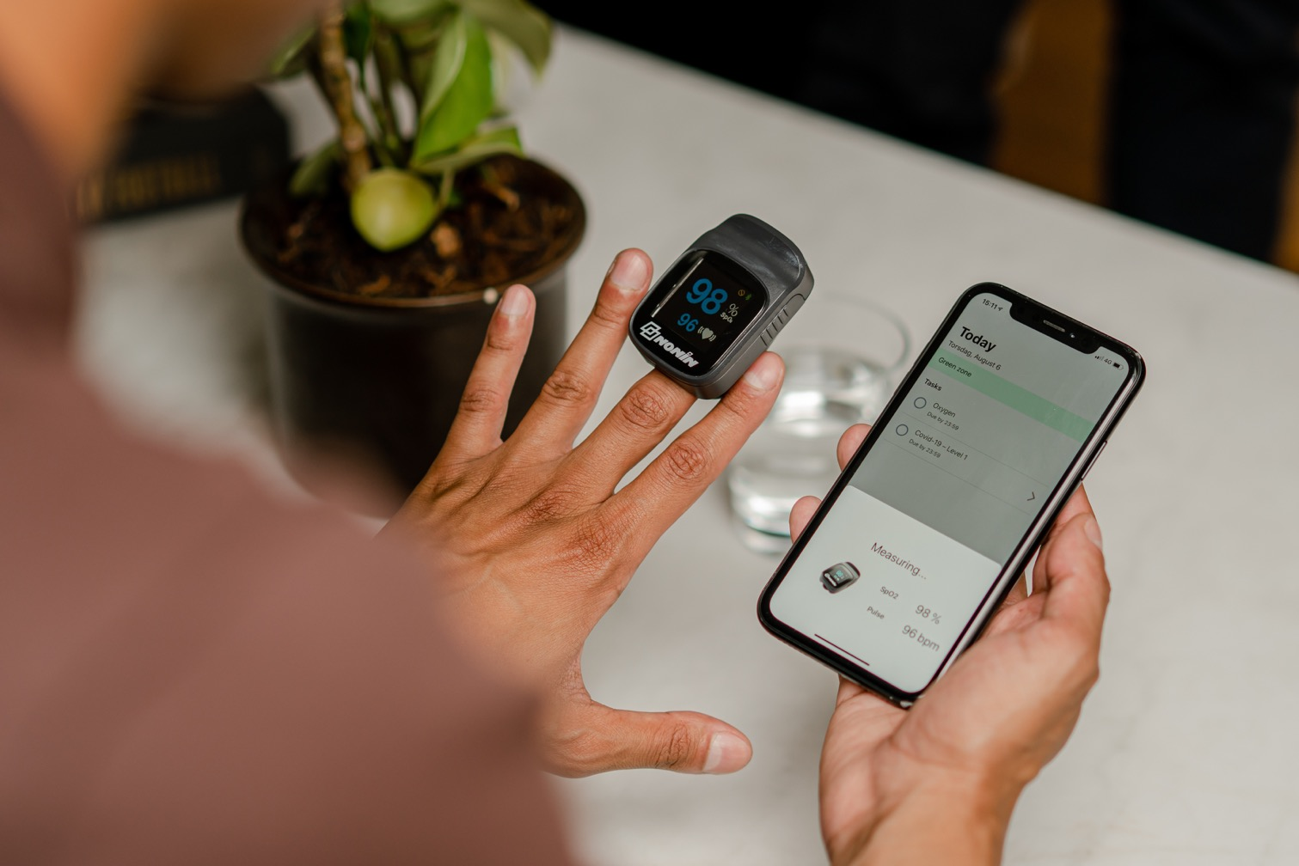
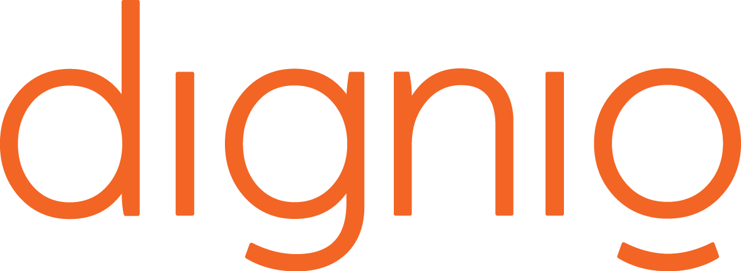
Dignio Connected Care Solution
Marianne Wilhelmsen
Head of Marketing and Communications
Notes:
Quality and Experience
User Centric
Nothing to install, nothing to remove
Predictable costs
Quality and experience
Working with the Norwegian healthcare system since 2010
Multidisciplinary team
Deployed at scale in Norway in long term conditions and COVID-19 detection and monitoring
User Centric
Simple user interface at both patient and clinician end
Created with our patient group and clinicians and constantly reviewed
Easy to use patient app and relevant data only feed to the clinician’s dashboard
Nothing to install, nothing to remove
Patient app available on iPad, BYOD, Android
Clinician’s dashboard accessible via web-based interface
Cloud-based Software as Service with open APIs
Predictable costs
Transparent costs: set up, training, license per patient (unlimited clinicial users), hardware
Hardware costs (integrated devices) kept low
The content is fully customisable locally by the clinicians/administrators

Slide 2
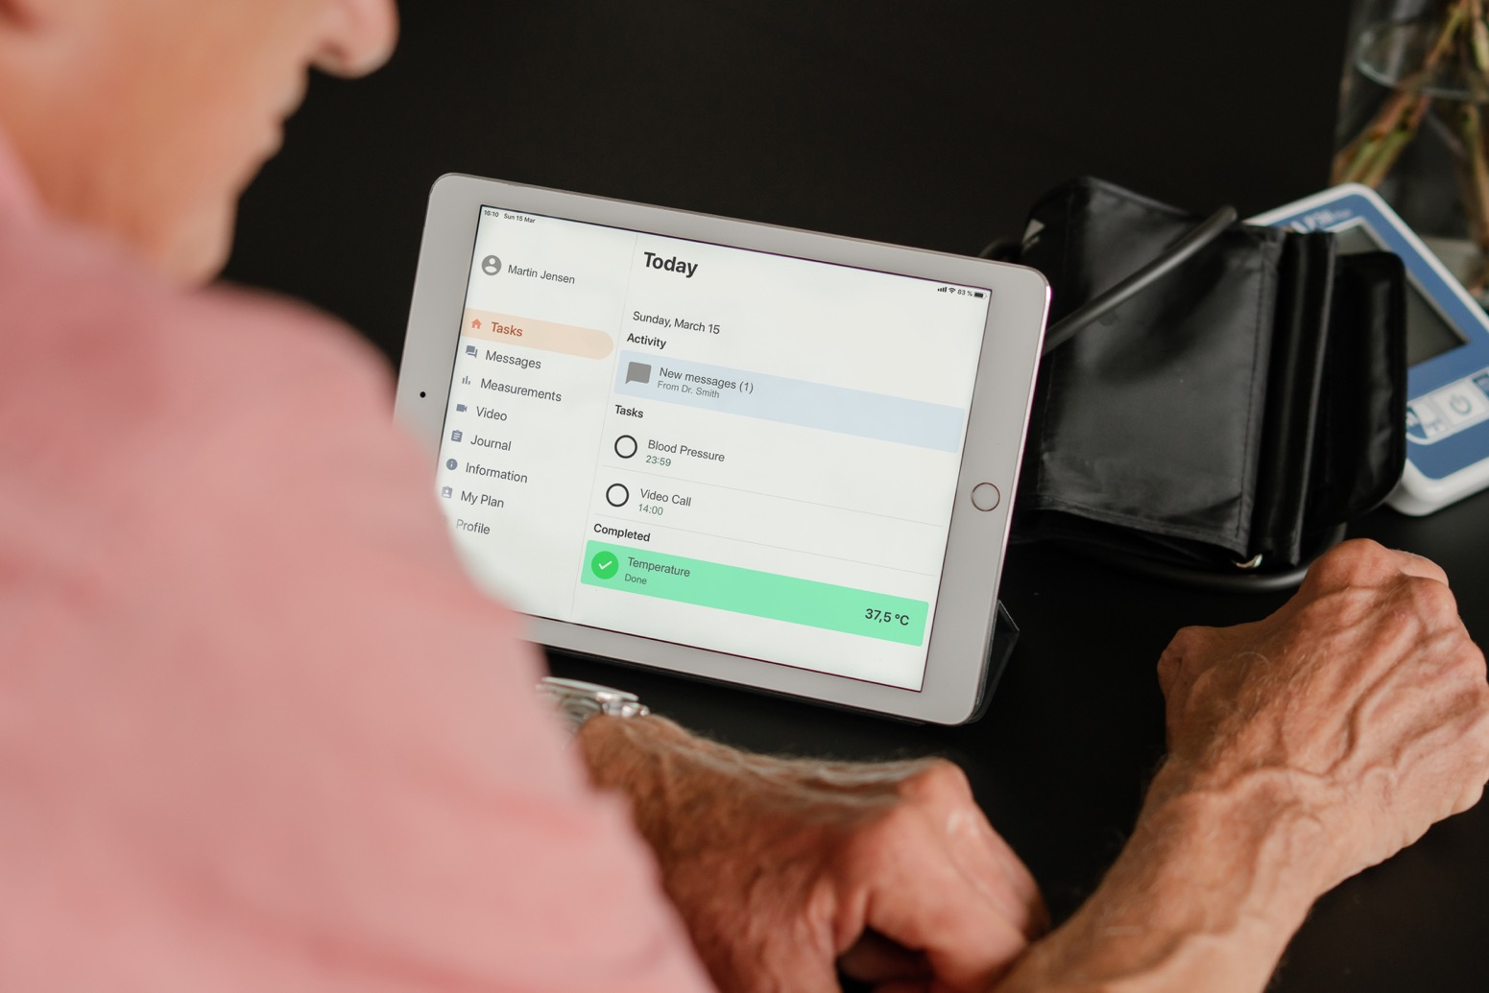
Notes:
Enabling healthcare professionals to safely follow up patients at home. The Dignio software is integrated with a variety of devices for health monitoring, and includes features like questionnaires, video, and self-management. The patient gets a tablet or downloads the MyDignio App on her smartphone – easy to use for all ages. Dignios oldest patient is over 90 years old.

Slide 3
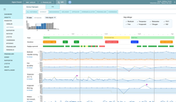
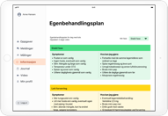
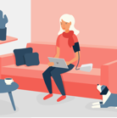
CE classified as software as a medical device class 1
Dignio Connected Care
A wide range of different e-health solutions combined in one comprehensive platform
Patient
Clinician
Telemedicine
Remote Patient Monitoring
Medication Compliance
Self-reporting
Home Lab
Self-management
Notes:
Telemedicine
Full telehealth functionality supporting remote healthcare through both video consultations and chat
Remote Patient Monitoring
Integrated with over 15 different medical measurement devices offering seamless remote patient monitoring
Medication compliance
Connected medication adherence support for both manually loaded and multidose pill packing
Self-reporting
Self-reporting functionality offering both clinically validated forms and customizable forms
Home lab
Home Lab support offering a wide range of tests such as WBC, Hemoglobin, CRP, GFR, HBA1C, etc.
Self-Management
Individual and highly customizable self treatment plans enabling best practice self-management

Slide 4
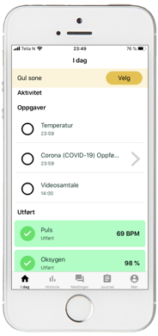
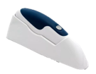
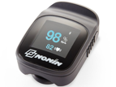
Measurements can also be registered manually by the patient
Bluetooth (or manual input from the patient’s own measurement device)
Thermometer
Blood pressure monitor
Pulse oximeter

Slide 5
Benefits of Dignio Connected Care
Safety and quality
Increased capacity
Reduced risk of infection
Reduced hospitalization
Notes:
Safety and quality
Safe follow up of individuals via questionnaires and vital signs measurements
Automatic triaging enables early intervention and ability to identify individuals with escalating symptoms¹, especially with risk groups
User friendly chat, video and information access reduce isolation
Increased capacity
Less need for physical presence; stable patinets monitored without the need for contact
Healthcare personnel in quarantine can follow-up patients from home
Automatic triaging ensures that the right patients are prioritized
Reduced risk of infection
Less physical contact between patients and healthcare personne
Patients with suspected COVID-19 can be idnetififed before attending non-COVID-19 clinics
Reduced hospitalization
Fewer patients hospitalized as deterioration is identified early and treated locally

Slide 6
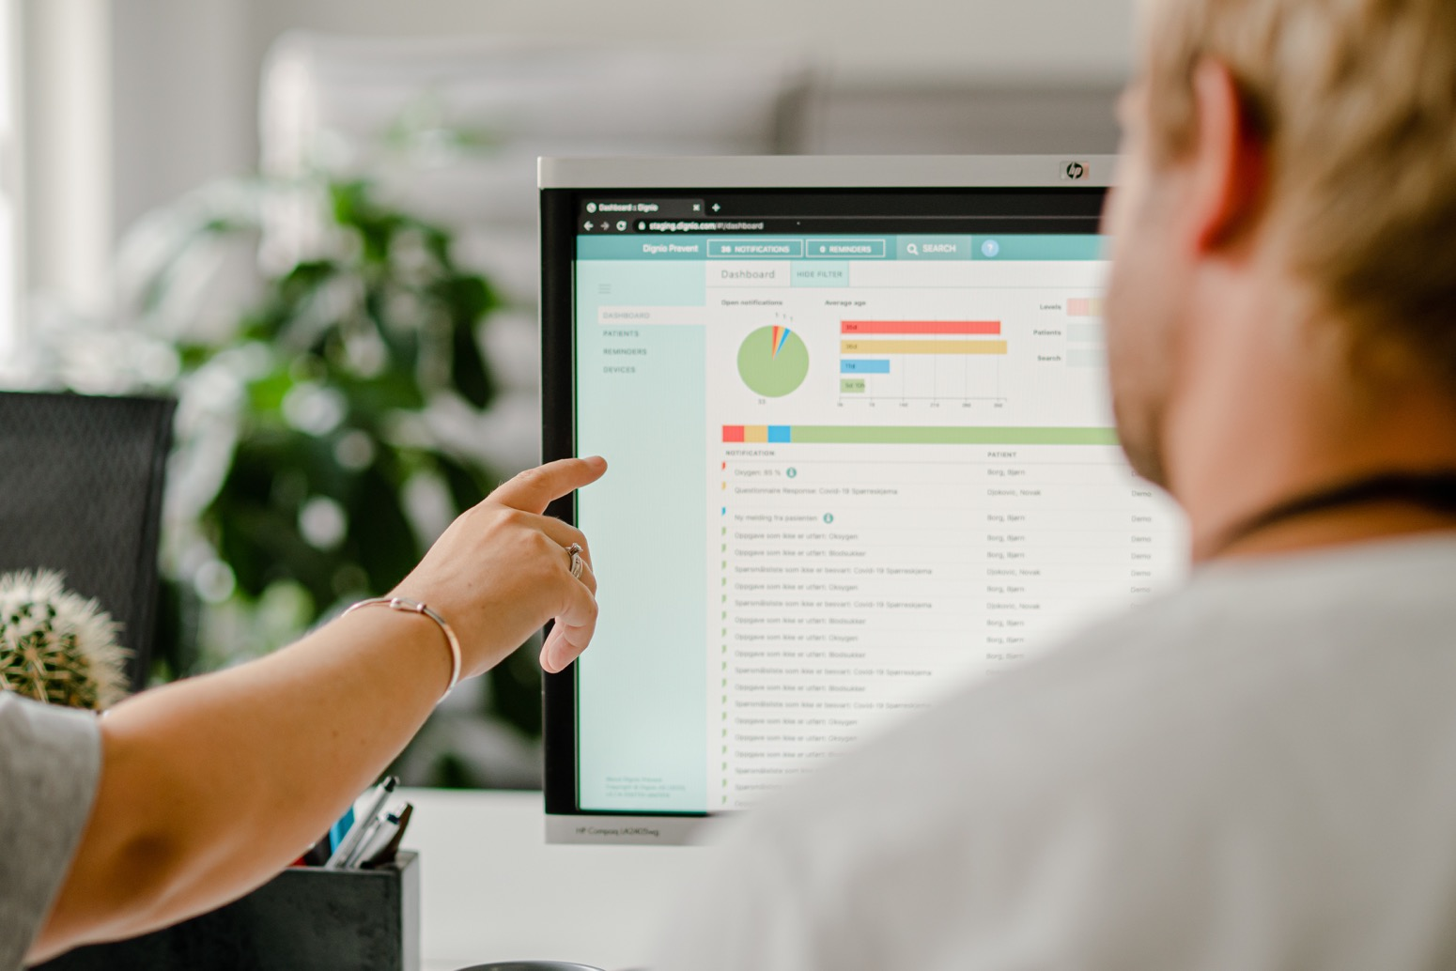
Notes:
Dignio Prevent, Dignios platform for healthcare personnell is developed to help employees triage fast so they find patients in need of attention promptly and identify patients early if their symptoms worsens.

Slide 7
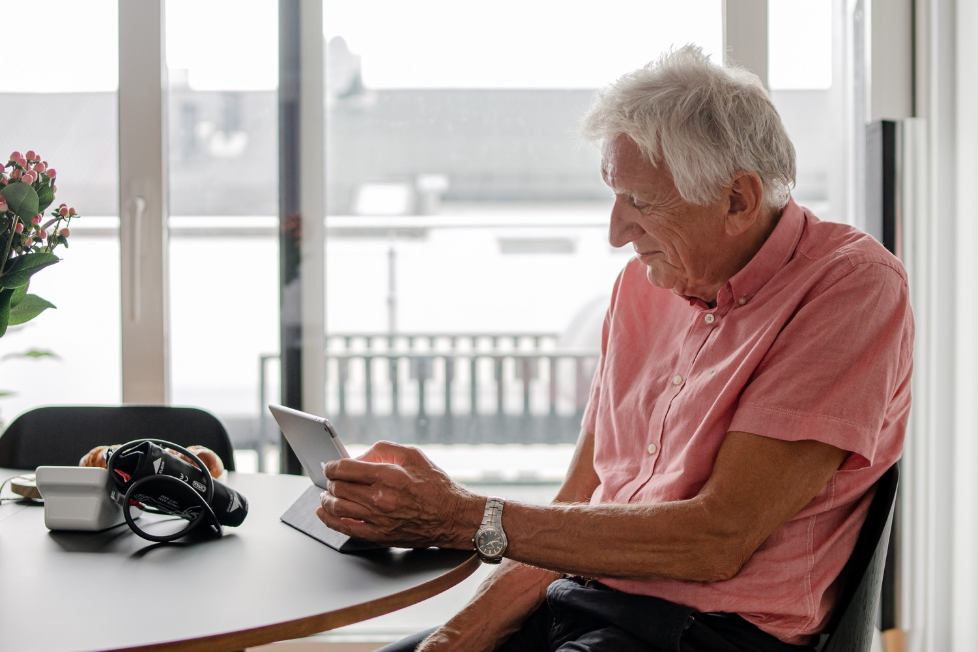
Notes:
Independent studies from the capitol of Norway, Oslo, shows that 66 percent of the patients feel in better control over their own health.

Slide 8
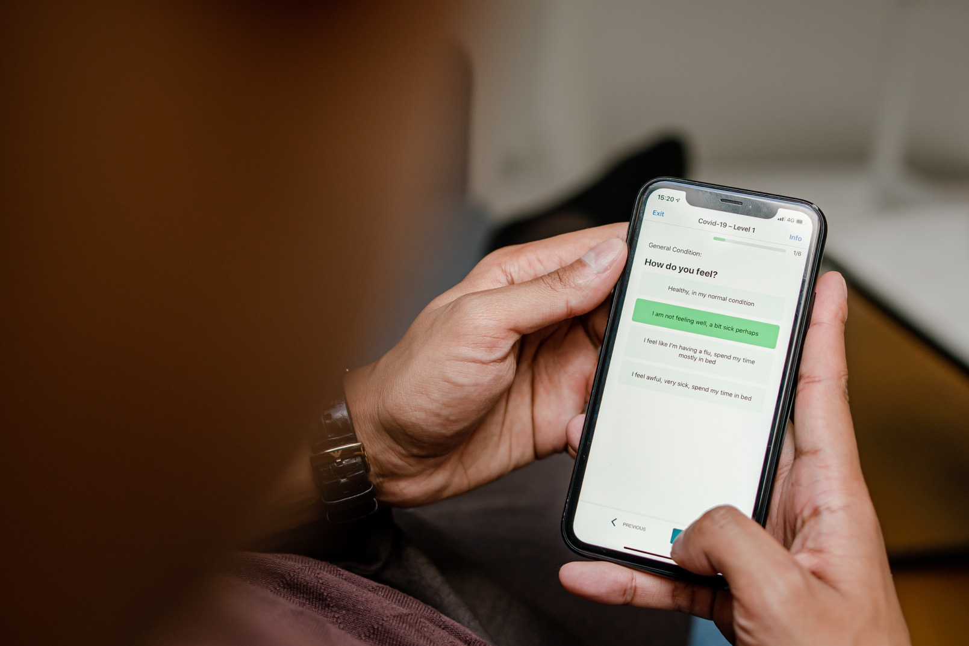
Covid-19 – Safer at home
Notes:
When Corona hit, Dignio saw our solution could be of use. During the last six months we have worked closely with some of our customers on making adjustments to better suit the challenge of following up many with the same infection but not the same condition. We have developed a questionnare the patients answer, and with our possibilities for video calls and chat, doctors can communicate with the patient to get even more information.

Slide 9
“With technology playing a vital role in our response to this pandemic so far, the MyDignio app will enhance our ability to provide high quality healthcare and reassurance to the people of Dudley. It will also allow healthcare staff to remotely manage the monitoring process of suspected coronavirus patients safely, and without infection risk to themselves.”
Dr. Jonathan Darby, GP and IT Lead, Dudley CCG

Slide 10
Thank you!

Slide 11
Please get in touch!
Marianne Wilhelmsen
Head of Marketing and Communications
marianne@dignio.com

