Slide 1


Erland develops ground breaking solutions for people with ostomy
Erland is a Norwegian development company for ostomy application products with associated spin-off products.

Slide 2
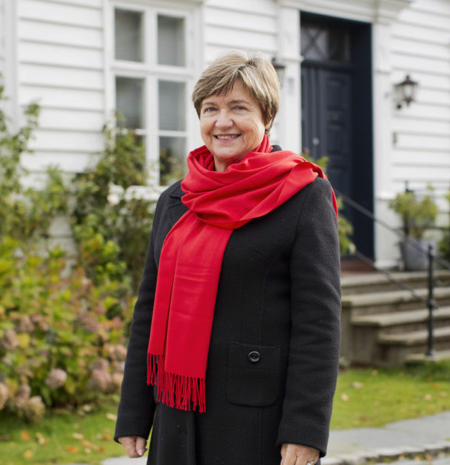
About Erland Care
It was never meant for Jofrid Erland to be an entrepreneur,
but when she got a challenge no one could help her with, she had no choice.
In 2007, her husband received a colon cancer surgery, and came home from the hospital
with a stoma bag. In order to prevent the leaks from the ostomy bag,
she had to take the matter into her own hands.
She realized that to get her husband back in social life, the odor and leakage from the ostomy pouch had to be stopped first.
On her way searching for a solution, she found out that more than 50% of people with stoma had these issues.
In 2017, Erland received a global patent on a stoma leakage device: Erland Care superabsorbent pad

Slide 3
Market
The population with stoma in the world is estimated to be around 7 millions and increasing.
Ostomy management methods involve the use of a wide range of so-called ostomy appliances with ostomy pouches dominating the market with a 80-90% market share.
The remaining 10-20% of this market is composed of accessories that are designed to be used with the pouches in order to make the user more comfortable and manage situations such as leaks.
Recent estimates of the global market for ostomy products indicate a value on about
US $3 billion. Projected annual growth rate of 4-8% because of the increase in coloncancer worldwide.

Slide 4
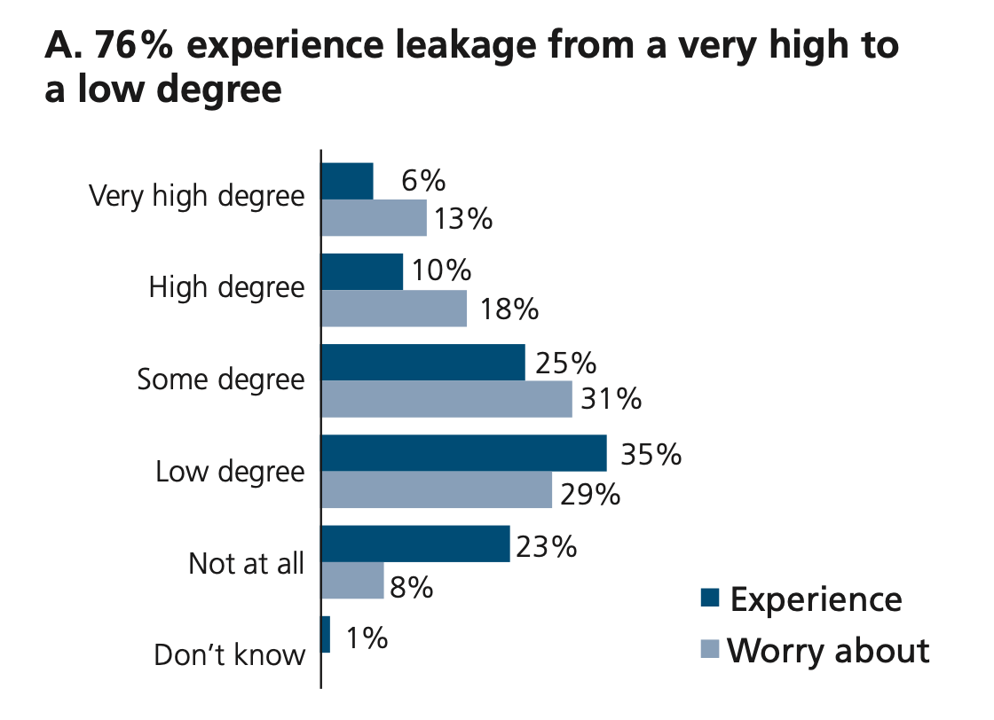
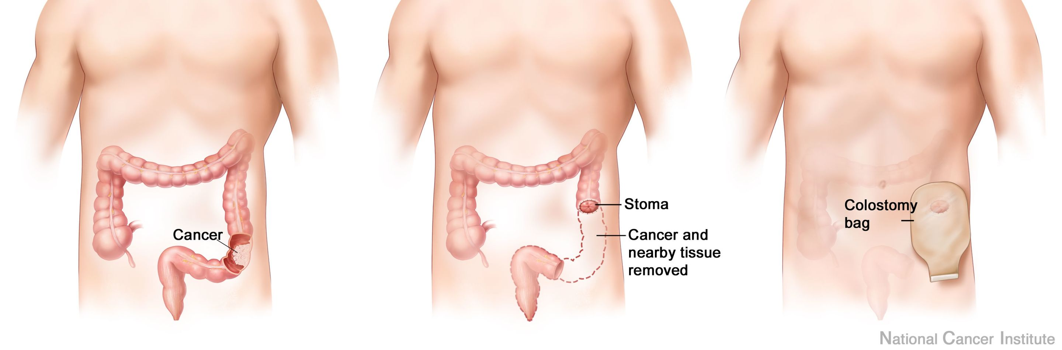
Challenge nr.1
The Ostomy Life Study: B.Braun 2015

Slide 5
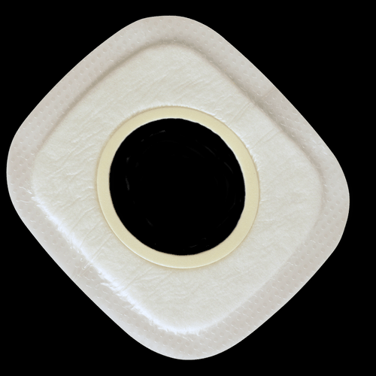
Product 1 – Erland Care Superabsorbent Pad
Ensures safe and stable attachment of bag and plate,
which in turn reduces the risk of leakage under the plate.
Absorbs leakage and seals it in the absorbent.
It prevents liquid from getting on the skin, clothing, bedding etc.
Perforated silicone as an adhesive gives the skin good ventilation and wounds
grow better. It also makes it easy to remove after use, also on established wounds.
Launched 2019/20

Slide 6
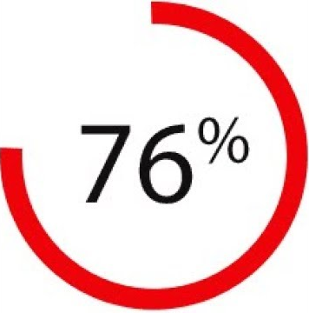
Challenge nr.2
76% Experience wounds or skin irritations under the stoma bag
Moisture-associated skin damage or MASD is defined as "inflammation and erosion of the skin caused by prolonged exposure to moisture and its contents, including urine, stool, perspiration, wound exudate, mucus, or saliva.

Slide 7
Product 2 – Erland Care Protective Skin
A superabsorbent skin plate that attaches directly to the skin,
and is located below the attachment plate of the ostomy bag.
The skin plate can absorb a significant volume of fluid and
reduce the risk of skin irritation around the stoma.
Launch Q1 - 2021

Slide 8
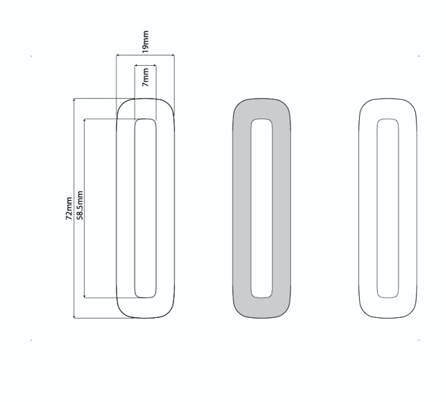
Pipeline:
How we work:
Close to user organizations
Make user studies/surveys on all actions
Following up on request from users and distributors
A solution based mindset
Always introduze products that are «groundbreaking»
Stoma stopper dressing (2021)
Wound care products (2021)
Next generation of stoma bags (2022)

Slide 9

Distribution
Our products are made available trought active distributors already offering stoma equipment.
But also online on www.erlandcare.no
We have now established distribution in:
Norway, Sweden, Denmark, Finland, Netherland, Belgium and Portugal.
We are now looking at partnerships in: UK, Germany, France, USA and other European countries.

Slide 10
Erland Care
- New technology that increase the quality of life to users.
- User driven innovation, solv real problems!
- Strong patent protection, with development opportunities.
- Products that challenge an existing market.
Erland is a Norwegian development company for ostomy
application products with associated spin-off products.

Slide 11
Erland develops ground breaking solutions for people with ostomy
www.erlandcare.no

